Slide 1
SQL Challenge
Sit with your teams and bask in your collective knowledge
Go to the Github page and download
  SQL Challenge ppt or pdf
  director_db_schema.txt
  Direct99_sqlite.csv
  AT_Retail_DB.db
Read SQL Challenge and Complete the exercises
EECS 484

Slide 2
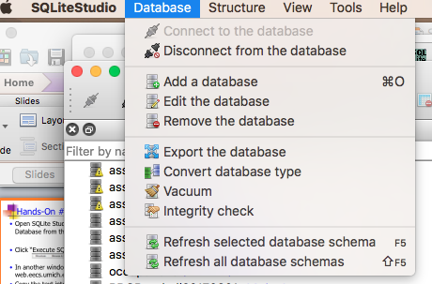
Directors Revisited ()
Open SQLite Studio and Select “Add a Database from the Database Menu”
Data Boot Camp!
Notes:
Positions #s
Schema:
playerID, year, gameNum, gameID, teamID, lgID, GP, startingPos
('ortizda01', 2012, 0, 'ALS201207100', 'BOS', 'AL', 1, 0),

Slide 3
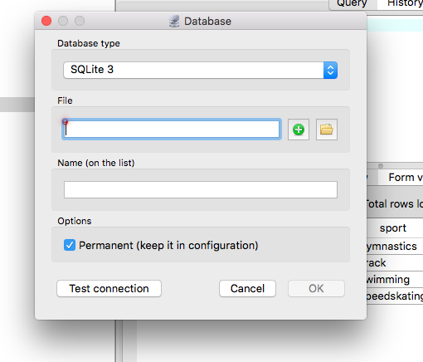
Directors Revisited ()
Click the green plus button to add a new file
Data Boot Camp!
Notes:
Positions #s
Schema:
playerID, year, gameNum, gameID, teamID, lgID, GP, startingPos
('ortizda01', 2012, 0, 'ALS201207100', 'BOS', 'AL', 1, 0),

Slide 4
Directors Revisited ()
Name it something appropriate like Director_DB and save it to a folder where you can find it.
Data Boot Camp!
Notes:
Positions #s
Schema:
playerID, year, gameNum, gameID, teamID, lgID, GP, startingPos
('ortizda01', 2012, 0, 'ALS201207100', 'BOS', 'AL', 1, 0),

Slide 5
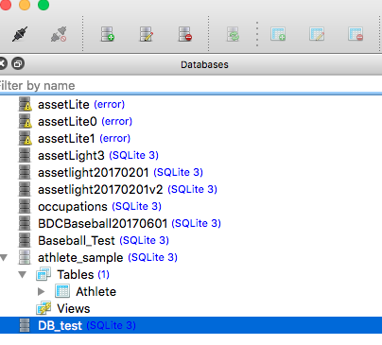
Directors Revisited ()
Select/highlight your DB File in the right hand window and click Connect to database
Data Boot Camp!
Notes:
Positions #s
Schema:
playerID, year, gameNum, gameID, teamID, lgID, GP, startingPos
('ortizda01', 2012, 0, 'ALS201207100', 'BOS', 'AL', 1, 0),

Slide 6
Directors Revisited ()
Open the file director_db_schema.txt
Highlight all of the text you see and copy it to your clipboard.
Data Boot Camp!
Notes:
Positions #s
Schema:
playerID, year, gameNum, gameID, teamID, lgID, GP, startingPos
('ortizda01', 2012, 0, 'ALS201207100', 'BOS', 'AL', 1, 0),

Slide 7
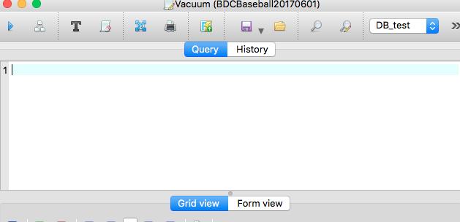
Directors Revisited ()
Paste all of the text in the query window, highlight all of the text and then click the “play” button.
Data Boot Camp!
Notes:
Positions #s
Schema:
playerID, year, gameNum, gameID, teamID, lgID, GP, startingPos
('ortizda01', 2012, 0, 'ALS201207100', 'BOS', 'AL', 1, 0),

Slide 8
Directors Revisited ()
If all has gone according to plan you should have a database in the left hand pane with one table “Directors” with nine columns
Data Boot Camp!
Notes:
Positions #s
Schema:
playerID, year, gameNum, gameID, teamID, lgID, GP, startingPos
('ortizda01', 2012, 0, 'ALS201207100', 'BOS', 'AL', 1, 0),

Slide 9
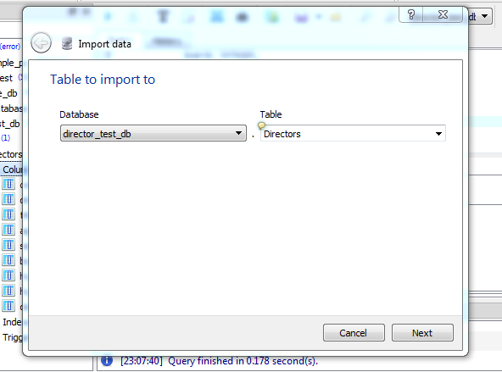
Directors Revisited ()
  Right click the table name Directors and select “Import into the table” You should get the image below.
Data Boot Camp!
Notes:
Positions #s
Schema:
playerID, year, gameNum, gameID, teamID, lgID, GP, startingPos
('ortizda01', 2012, 0, 'ALS201207100', 'BOS', 'AL', 1, 0),

Slide 10
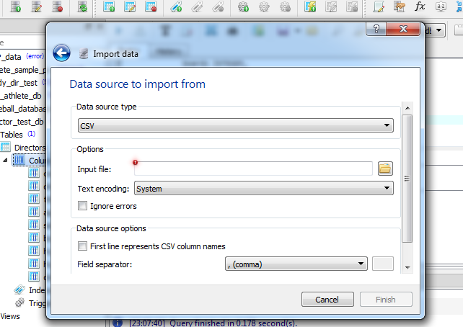
Directors Revisited ()
  Click Next which will bring you to the screen below. Follow the instructions to locate and import the file “direct99_sqlite.csv”
Data Boot Camp!
Notes:
Positions #s
Schema:
playerID, year, gameNum, gameID, teamID, lgID, GP, startingPos
('ortizda01', 2012, 0, 'ALS201207100', 'BOS', 'AL', 1, 0),

Slide 11
Directors Revisited ()
  It may take a little while to load the data in to the table (especially on a PC) but I promise you that it is working! ☺ When the data is loaded.
  After the data is loaded you should try three things
    Write queries that gives you the names of all of the directors for Apple, JP Morgan and Caterpillar
    Reproduce the query from yesterday that gives you all of the networks pairs for the corporate interlocks.
Data Boot Camp!
Notes:
Positions #s
Schema:
playerID, year, gameNum, gameID, teamID, lgID, GP, startingPos
('ortizda01', 2012, 0, 'ALS201207100', 'BOS', 'AL', 1, 0),

Slide 12
Directors Revisited ()
  HINTS
    You probably don’t know how the company is named. But you can do a wild card search with the % symbol and the LIKE commands. For example if I was looking for Sarah Lee I might say “SELECT* from Directors WHERE company_name LIKE ‘%sarah%’
    Did we join the table with itself yesterday?
Data Boot Camp!
Notes:
Positions #s
Schema:
playerID, year, gameNum, gameID, teamID, lgID, GP, startingPos
('ortizda01', 2012, 0, 'ALS201207100', 'BOS', 'AL', 1, 0),

Slide 13

Ann Taylor and SQL – “SELECT”
“Good Morning! Rumor has it that you have learned some SQL. That’s great. I would like to give you access to our DB. Go to the Github page, download AT_Retail_DB.db and add it to SQLite Studio with the “Add A Database” Functionality

Slide 14
Ann Taylor and SQL – “SELECT”
“Get Familiar with the DB! Try running SELECT * FROM Employees LIMIT 10 to get a sense of what’s in that table. Repeat for the other tables! Then I will have some questions for you!

Slide 15
Ann Taylor and SQL – “SELECT”
“My name is Jenna! How might you find out my employee information?”

Slide 16

Ann Taylor and SQL – “SELECT”
“You know..I think this Crystal Pendant is radiant! Can you write a query to tell me which employees have sold this item?”

Slide 17
Ann Taylor and SQL – “SELECT”
“So I am really competitive! Can you write a query that gives me the employee ID, first name, last name and total sales of each employee? I want to know if I am at the top! Remember, I’m JENNA!!”
(Hint-You may have to join three tables!)

Slide 18
APPENDIX
EECS 484

Slide 19
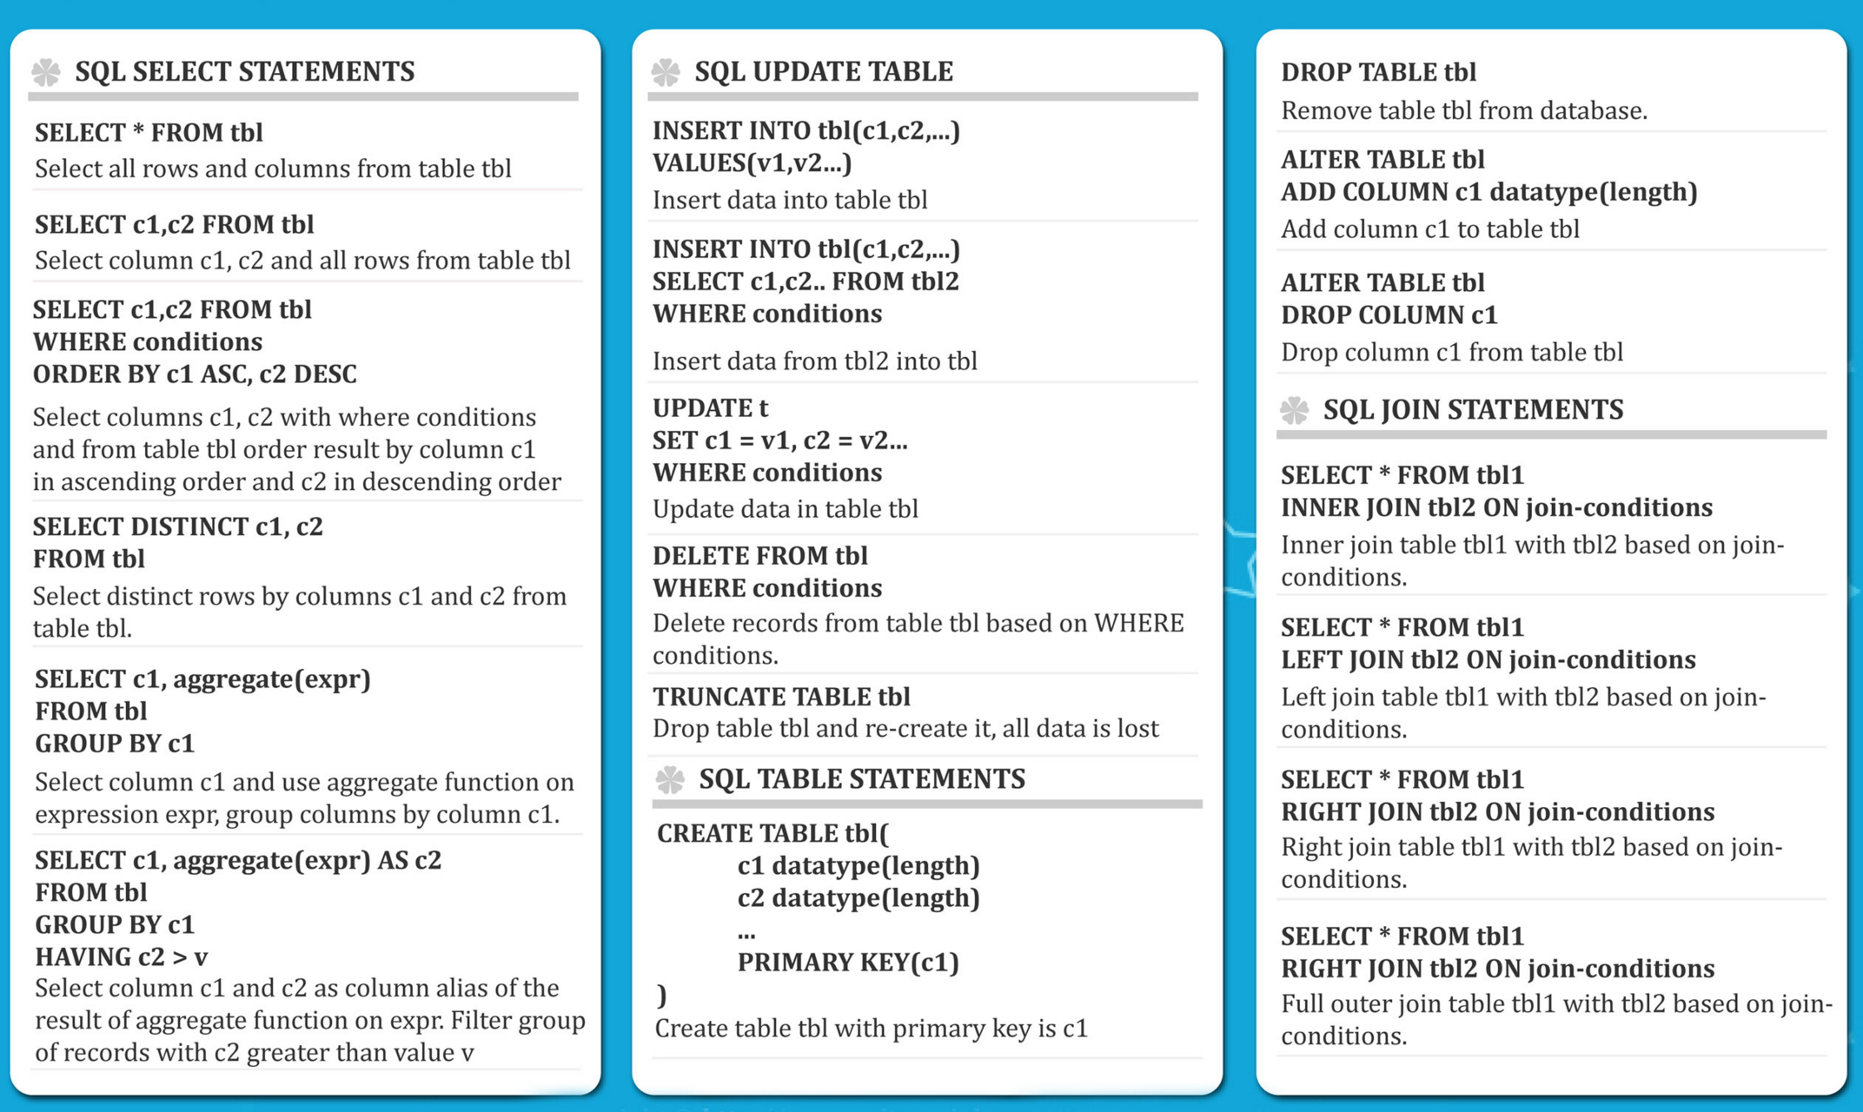
Data Boot Camp!

Slide 20
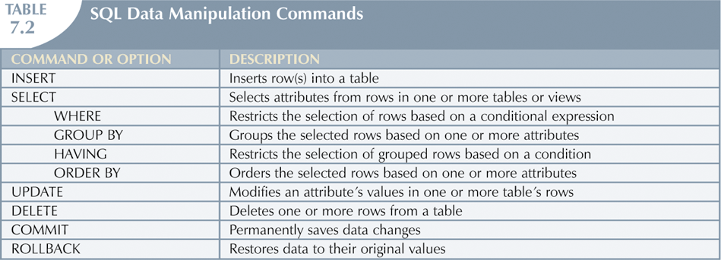
Data Boot Camp!

Slide 21
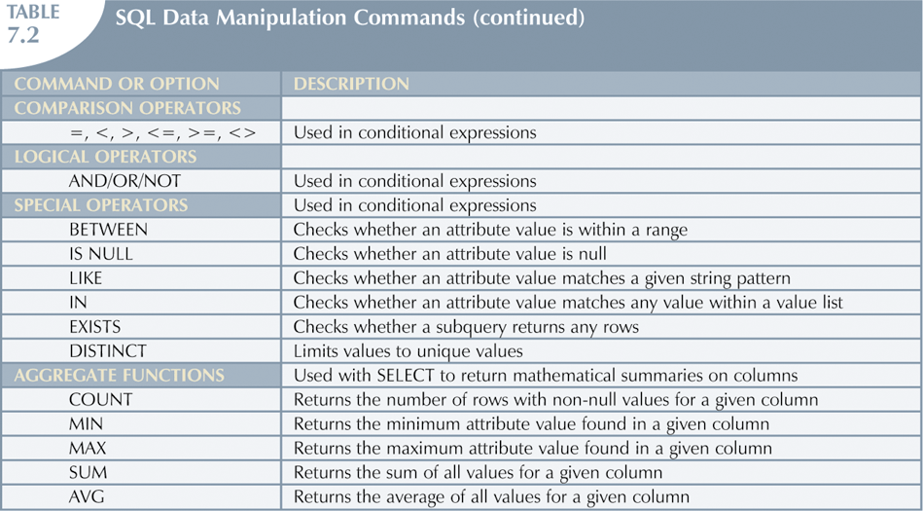
Data Boot Camp!

Slide 22
Useful Resoruces
URLS
  http://www.w3schools.com/sql/
  http://www.tutorialspoint.com/sqlite/
  http://www.tutorialspoint.com/sqlite/sqlite_python.htm
Books
  Learning SQL – Alan Beaulieu
Online Courses
  Udemy – The Complete SQL Bootcamp ($)
Data Boot Camp!

